Slide 1
Chapter 10: The Chi-square Test and Measures of Association

Slide 2
The Concept of Chi-square as a Statistical Test
Chi-square test.
Application of chi-square test.
Referred to as goodness-of-fit test.
Notes:
Satisfies Learning Objective 10.1: Summarize the application of a chi-square test.
Chi-square test (pronounced kai-square and written as χ²) is an inferential statistical technique designed to test for significant relationships between two variables organized in a bivariate table.
Application of Chi-square test: Chi-square test can also be applied to distribution of scores for a single variable.
Referred to as the goodness-of-fit test, the chi-square can compare the actual distribution of a variable with a set of expected frequencies.

Slide 3
The Concept of Statistical Independence
Statistically independent.
Identifies statistical independence in a bivariate table.
Two variables, statistically independent.
Notes:
Satisfies Learning Objective 10.1: Summarize the application of a chi-square test.
Statistically independent: When two variables are not associated, one can say that they are statistically independent. That is, an individual’s score on one variable is independent of his or her score on the second variable.
Identifies statistical independence in a bivariate table by comparing the distribution of the dependent variable in each category of the independent variable.
Two variables, statistically independent: When two variables are statistically independent, the percentage distributions of the dependent variable within each category of the independent variable are identical.

Slide 4
The Structure of Hypothesis Testing with Chi-square (1 of 4)
The assumptions.
Stating research and null hypotheses.
Concept of expected frequencies.
Calculating expected frequencies.
Notes:
Satisfies Learning Objective 10.2: Calculate and interpret a test for the bivariate relationship between nominal or ordinal variables.
The assumptions: The chi-square test requires no assumptions about the shape of the population distribution from which the sample was drawn. However, like all inferential techniques, it assumes random sampling. It can be applied to variables measured at a nominal and/or an ordinal level of measurement.
Stating the research and the null hypotheses:
The research hypothesis (H₁) proposes that the two variables are related in the population.
H₁: The two variables are related in the population.
The null hypothesis (H₀) states that no association exists between two cross-tabulated variables in the population, and therefore, the variables are statistically independent.
The concept of expected frequencies:
Assuming that the null hypothesis is true, we compute the cell frequencies that we would expect to find if the variables are statistically independent. These frequencies are called expected frequencies (and are symbolized as f_{e}).
The chi-square test is based on cell-by-cell comparisons between the expected frequencies (f_{e}) and the frequencies actually observed (observed frequencies are symbolized as f_{o}).
Calculating the expected frequencies:
The difference between f_{o} and f_{e} will determine the likelihood that the null hypothesis is true and that the variables are, in fact, statistically independent.
We can calculate the expected frequencies using this formula: $f_{e}=\frac{\left(Column marginal\right)\left(Row marginal\right)}{N}$.

Slide 5
The Structure of Hypothesis Testing with Chi-square (2 of 4)
Calculating obtained chi-square.
Sampling distribution of chi-square.
Determining degrees of freedom.
Making a final decision.
Notes:
Satisfies Learning Objective 10.2: Calculate and interpret a test for the bivariate relationship between nominal or ordinal variables.
Calculating the obtained chi-square:
The next step in calculating chi-square is to compare the differences between the expected and observed frequencies.
Obtained chi-square statistic: $x^{2}=\sum{\frac{{\left(f_{o}−f_{e}\right)}^{2}}{f_{e}}}$.
The sampling distribution of chi-square: The sampling distribution of chi-square tells the probability of getting values of chi-square, assuming no relationship exists in the population.
Determining the degrees of freedom:
With cross-tabulation data, we find the degrees of freedom by using their formula, $df=\left(r−1\right)\left(c−1\right)$, where r is the number of rows and c is the number of columns.
Yates’s correction for continuity: $x_{c}^{2}=\sum{\frac{{\left(│f_{o}−f_{e}│−0.5\right)}^{2}}{f_{e}}}$.
Making a final decision:
With the Yates’s correction, the corrected chi-square is 57.54. Refer to Table 10.6 for calculations.
We can establish that the probability of obtaining a chi-square of 57.54 is less than 0.001, if the null hypothesis were true.

Slide 6
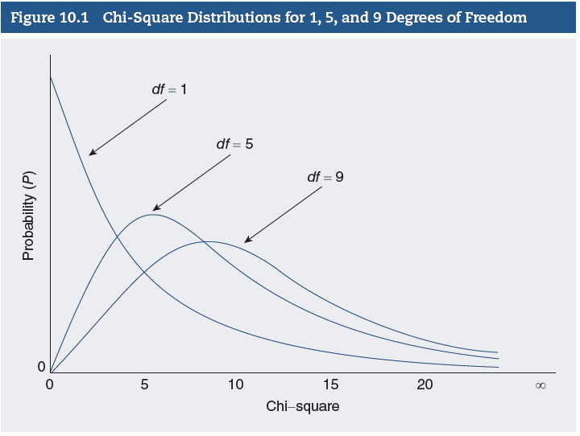
The Structure of Hypothesis Testing with Chi-square (3 of 4)
Notes:
Satisfies Learning Objective 10.2: Calculate and interpret a test for the bivariate relationship between nominal or ordinal variables.
Some of the main properties of the chi-square distributions that can be observed in this figure are as follows:
The distributions are positively skewed.
Chi-square values are always positive. The minimum possible value is zero, with no upper limit to its maximum value. A chi-square of zero means that the variables are completely independent and the observed frequencies in every cell are equal to the corresponding expected frequencies.
As the number of degrees of freedom increases, the chi-square distribution becomes more symmetrical and, with degrees of freedom greater than 30, begins to resemble the normal curve.

Slide 7
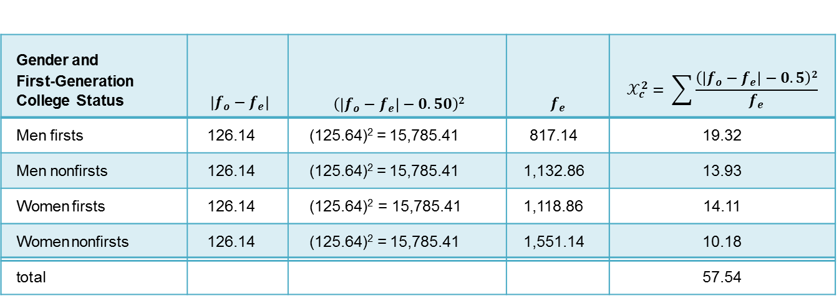
The Structure of Hypothesis Testing with Chi-square (4 of 4)
Table 10.6 Calculating Yates’s Correction
Gender and First-Generation College Status | $\left|f_{o}−f_{e}\right|$ | $\left(\left|f_{o}−f_{e}\right|−0.50\right)2$ | $$f_{e}$$ | $$𝒳_{c}^{2}= \sum{\frac{\left(\left|f_{o}−f_{e}\right|−0.5\right)2}{f_{e}}}$$
Men firsts | 126.14 | (125.64)² = 15,785.41 | 817.14 | 19.32
Men nonfirsts | 126.14 | (125.64)² = 15,785.41 | 1,132.86 | 13.93
Women firsts | 126.14 | (125.64)² = 15,785.41 | 1,118.86 | 14.11
Women nonfirsts | 126.14 | (125.64)² = 15,785.41 | 1,551.14 | 10.18
total |  |  |  | 57.54
Notes:
Satisfies Learning Objective 10.2: Calculate and interpret a test for the bivariate relationship between nominal or ordinal variables.
Table 10.6: Calculating Yates’s Correction.
Here are some of the main properties of the chi-square distributions that can be observed in this figure:
The distributions are positively skewed.
Chi-square values are always positive. The minimum possible value is zero, with no upper limit to its maximum value. A chi-square of zero means that the variables are completely independent and the observed frequencies in every cell are equal to the corresponding expected frequencies.
As the number of degrees of freedom increases, the chi-square distribution becomes more symmetrical and, with degrees of freedom greater than 30, begins to resemble the normal curve.

Slide 8
Proportional Reduction of Error
Measures of association.
Four measures of association.
Proportional reduction of error.
Range of PRE.
Notes:
Satisfies Learning Objective 10.4: Explain the concept of proportional reduction of error.
Measures of association: These measures enable to use a single summarizing measure or number for analyzing the pattern of relationship between two variables.
Four measures of association:
Lambda (measures of association for nominal variables).
Gamma.
Kendall’s tau-b (measures of association between ordinal variables).
Cramer’s V (a chi-square related measure of association).
Proportional reduction of error often abbreviated as PRE: According to the concept of PRE, two variables are associated when information about one variable (an independent variable) can help us improve our prediction of the other variable (a dependent variable). The conceptual formula for all PRE measures of association is
$$PRE=\frac{E_{1}−E_{2}}{E_{1}}$$
where E₁ is the errors of prediction made when the independent variable is ignored (Prediction 1) and E₂ is the errors of prediction made when the prediction is based on the independent variable (Prediction 2).
Although this general formula provides a framework for all PRE measures of association, only lambda is illustrated with this formula.
All PRE measures are based on comparing predictive error levels that result from each of the two methods of prediction.
Range of PRE: PRE measures of association can range from 0.0 to ±1.0: A PRE of zero indicates that the two variables are not associated; information about the independent variable will not improve predictions about the dependent variable.

Slide 9
Lambda: A Measure of Association for Nominal Variables
Asymmetrical measure.
Range of values.
Always zero in specific situations.
Notes:
Satisfies Learning Objective 10.5: Apply and interpret measures of association: Lambda, Cramer’s V, gamma, and Kendall’s tau-b.
Lambda is an asymmetrical measure used to determine the strength of the relationship between two nominal variables.
An asymmetrical measure will vary depending on which variable is considered the independent variable and which the dependent variable.
Always zero in situations: Lambda is always zero in situations in which the mode for each category of the independent variable falls into the same category of the dependent variable. A problem with interpreting lambda arises in situations in which lambda is zero, but other measures of association indicate that the variables are associated.

Slide 10

Cramer’s V: A Chi-square-related Measure of Association for Nominal Variables
Alternative measure of association.
Formula: $V=\sqrt{\frac{x^{2}}{N\left(m\right)}}$ .
Notes:
Satisfies Learning Objective 10.5: Apply and interpret measures of association: lambda, Cramer’s V, gamma, and Kendall’s tau-b.
Cramer’s V is an alternative measure of association that can be used for nominal variables. It is based on the value of chi-square and ranges between 0 to 1, with 0 indicating no association and 1 indicating perfect association. It cannot take negative values, it is considered a nondirectional measure.
Cramer’s V is somewhat limited because the results cannot be interpreted using the PRE framework. It is calculated using the formula:
$$V=\sqrt{\frac{x^{2}}{N\left(m\right)}}$$
where m is the smaller of $(r–1) or (c–1).$

Slide 11
Gamma and Kendall’s Tau-b: Symmetrical Measures of Association for Ordinal Variables
Symmetrical measures of association.
Strength and direction of association.
Can be positive or negative.
Notes:
Satisfies Learning Objective 10.6: Interpret output for chi-square and measures of association.
Gamma and Kendall’s tau-b are symmetrical measures of association suitable for use with ordinal variables or with dichotomous nominal variables. This means that their value will be the same regardless of which variable is the independent variable or the dependent variable.
Strength and direction of association: Both gamma and Kendall’s tau-b can vary from 0.0 to ±1.0 and provide us with an indication of the strength and direction of the association between the variables.
Can be positive or negative:
A gamma or Kendall’s tau-b of 1.0 indicates that the relationship between the variables is positive and that the dependent variable can be predicted without any errors based on the independent variable.
A gamma of −1.0 indicates a perfect, negative association between the variables.

